Slide 1
Threat Modeling
Osvaldo Calles

Slide 2
Index
Why Threat Modeling
Threat Modeling Process
How an Adversary Sees an Application
Diagrams
Report

Slide 3
Index
Why Threat Modeling
Threat Modeling Process
How an Adversary Sees an Application
Diagrams
Report

Slide 4
Why Threat Modeling
What is a threat model ?
Is a method of assessing and documenting the security risks associated with an application. This methodology can help development teams identify the security strengths and weaknesses of the system and can serve as a basis for investigating potential and testing and investigation vulnerabilities.
An adversary cannot attack a system without a method of supplying it with data

Slide 5
Why Threat Modeling
Static Analysis
Code Review is slow and tedious affair, and Static Analysis Tools are very limited which can miss bugs and probably will not find architecture-level vulnerabilities.
Brainstorming
Although participants in a brainstorming session sometimes find serious flaws in an application, they often do so only because they already have knowledge in the application as well as security experience.

Slide 6
Why Threat Modeling Phases in the Application Security Cycle
1
Requirements
gathering
2
Securing
design
3
Architecture
review and
threat model
7
Integrating
feedback
6
Securing
deployment
4
Implementation
level analysis
5
Penetration
testing

Slide 7
Why Threat Modeling How team members contribute to the Threat Model
Threat vs. vulnerability data, security strengths and weaknesses, feedback into design and implementation process
As owner of the process, oversees threat modeling and security assessments
Security Process
Manager
Assessment of
The System’s
Security
Manage the schedule; own individual documents
Threats as penetration goals; verify or disprove mitigations
Program
Managers
Threat
Model
Penetration
Testing Plan
Provide design and implementation details, determine and investigate threats
Architects and
Developers
Components with a high security risk, threats that require detailed investigation
Testers
Drive critical analysis of the system, determine and investigate threats
Direct Code
Review
Notes:
Relacionar cada role con las personas que trabajan en el producto final.

Slide 8
Threat Modeling Process General Definitions
Threat
Entry Point
DREAD
Asset
Vulnerability
STRIDE
Trust Level
Notes:
Threat: Objetivos del atacante
Asset : Es un recurso abstractacto o concreto que el Sistema debe proteger del atacante. Pueden ser transitivos
Attack path: Es la secuencia de condiciones que deben existir en un Threat Tree para que se logre el ataque o explotación de la vulnerabilidad.
Condition: es algo que tiene que suceder en el Attack Path para que sea vulnerable.
DREAD: escala del riego asociado a las vulnerabilidades. Damage potential – Reproducibility – Exploitability – Affected Users- Discoverability.
Entry Point: Es una interfaz que el Sistema para comunicarse con el ext erior.
External Dependencie: Dependencia que se tiene sobre otro sistema
External Entity: Es otro componente que se comunica con el nuestro a atraves de los Entry Points.
Penetration Test: Es la prueba de la penetración.
Risk: es la caracterización del danio de una vulnerabilidad o condición.
Security Strengh: Es la efectividad del sistema para mitigar un threat.
Security weakness: es una mitigación insuficiente de un Threat.
STRIDE: Describe los efectos de los Threats. Spoofing – Tampering – Repudiation – DoS – Elevacion de Privilegios.
System: Es una coleccion de components que exponent cierta funcionalidad a entidades externas.
Threat: Es lo que el atacante le hara al Sistema. Los Threat siempre existen a pesar de las mitigaciones.
Threat Model: Es un DOCUMENTO que prove informacion del historial del Sistema, threat profile.
Threat Profile: Es la lista de todas las posibles ataques que un atacante tiene y explica lo que el atacante podria llegar a hacer con el Sistema o Assets.
Threat Tree: Describe todos los caminos de ataque en forma de árbol. El Root es el Threat.
Entry Points: Son todas las interfaces que expone el component con el exterior. Es el punto de entrada o intercambio de datos entre el exterior y el componente.
Assets: Puede ser abstracto o tangible y es algo que el atacante quiere robar, modificar o manipular. Es lo que motiva al atacante a hackear el sistema.
Trust level: Son los privilegios o autenticaciones que require un component externo para usar una Interfaz como Entry Points.
Use Scenario: Como se pretende o no se pretende usar el Sistema.
Vulnerability: Es una falla en la seguridad del Sistema que permite al atacante realizer su ataque (Threat).

Slide 9
Threat Modeling Process Phases
Understand the
Adversary’s View
Characterize the
Security of the System
Determine
Threats
Entry Points
Use
Scenarios
Identify
Threats
Assets
Assumptions
And
Dependencies
Analyze Threats/
Determine
Vulnerabilities
Trust Levels
Model
The System

Slide 10
How an Adversary Sees an Application Assets
Corporate computer systems or corporate data
Paper files
Fax Machine
Soft Drinks
Notes:
Assets fisicos
- la informacion en las computadoras
Assets abstractos:
- La seguridad de los empleados que trabajan ahi
La reputacion de la compania
La disponibilidad de los recursos (que funcione la red)

Slide 11
How an Adversary Sees an Application Entry Points
Back door
Window
Window
Window
Stairs to parking garage
Window
Window
Main entrance
Window
Power or telecom
Water supply
Gas, heating, or air conditioning

Slide 12
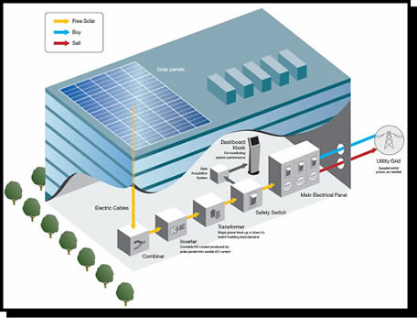
How an Adversary Sees an Application External Dependencies

Slide 13
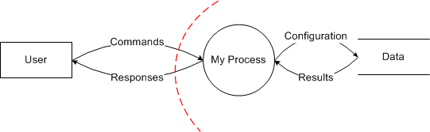
Diagrams Data Flow Diagram
Is a graphical representation of the “FLOW” of data through a system, modeling its process aspects. Show what kind of information will be input to and from the system.
Notes:
Design
High-Level Threat Modeling
Implementation
Feature Threat Modeling
Pen-Testing

Slide 14
Diagrams Threat Tree
Threat #1
AND
1.1
Condition A
1.2
Condition B
1.2.1
Condition C
Notes:
Attack Trees are conceptual diagrams showing how an asset, or target, might be attacked

Slide 15
Report weaknesses of a system
Average DREAD (risk)
2.2
5
3
4
5
2
Notes:
When it comes to measuring and raking the threats risk level, DREAD, the acronym for the following points, is a great technique provided by Microsoft for this purpose.
Damage potential: how much damage can this threat do to our system?
Reproducibility: is it easy to be reproduced?
Exploitability: how much effort and experience does it require to be exploited?
Affected users: in case the threat became an attack, how many users can be affected?
Discoverability: As Howard and LeBlanc said in their Book “Writing Secure Code“, it is good to assume that all threats are discoverable to some extent, therefore we can rank them to the highest metric.
So basically we rank the threat level based on DREAD on a scale of ’0′ to ’10′ where greater the number is, greater the threat. Better user 0 - 3
Finally we can calculate the value of the Risk(DREAD) by averaging the values like so:Risk = (D + R + E + A + D) / 5

Slide 16
Exercise - The FastBuck Book Company
The FastBuck Book Company was formed a few years ago as a partnership between a failed bookmaker, a snake oil seller, and the nephew of a mob chief. Despite police attention, the company has managed to remain in business for a number of years.
Here’s how the company does business: Orders are sent in on coupons that customers clip from magazines such as Slug Lovers’ Monthly and The Gravel Journal. (The company tends to advertise in magazines with a readership profile showing high gullibility.) Naturally, this is a cash-only business. Any orders received without payment are discarded.
The company doesn’t actually publish books. It simply has a supply of different covers. The appropriate cover for each order is glued to the generic book, which is sent to the hapless customer. Long-standing customers may receive several copies of the generic book with different covers. This is regarded by FastBuck as a hazard of being a customer.
The generic book was written in 1908 by a prominent bore. It rambles over such a wide range of topics that it is almost impossible for customers to complain of irrelevance. The book is also so stunningly soporific that it is doubtful anyone has ever read it. Complaints are few at FastBuck, and those that do arrive are ignored.
Repeat customers are in for a special treat at FastBuck. Those who attempt to deal with the company on more than one occasion are thought to be naive enough to fall for anything. An invoice for the previously ordered book is generated and sent in the hope that the customer will pay the invoice, even though cash arrived with the original order.
Benedict Shady is an analyst who had an unfortunate relationship with the daughter of one of the partners—unfortunate because the daughter is now in a delicate condition, and doubly unfortunate because her father is the one with mob connections. In return for not being thrown off the Brooklyn Bridge, Benedict has agreed to do an analysis of the business.
Benedict is presumably a better lover than analyst

Slide 17
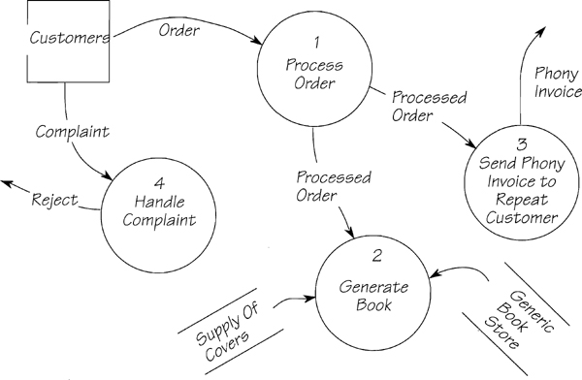
Exercise - Find errors

Slide 18
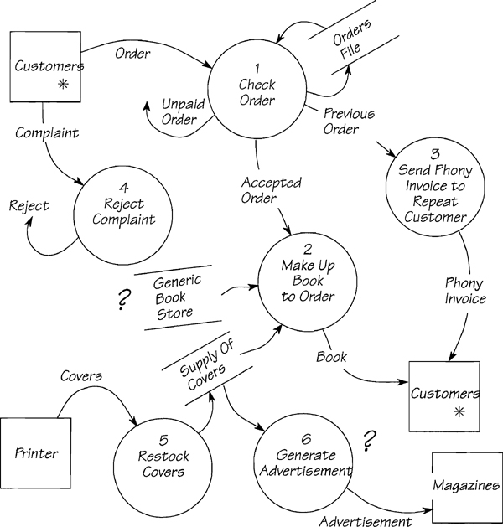
Exercise - Solution

Slide 19
Content taken from Threat Modeling book .Microsoft.

Slide 20


